Slide 1
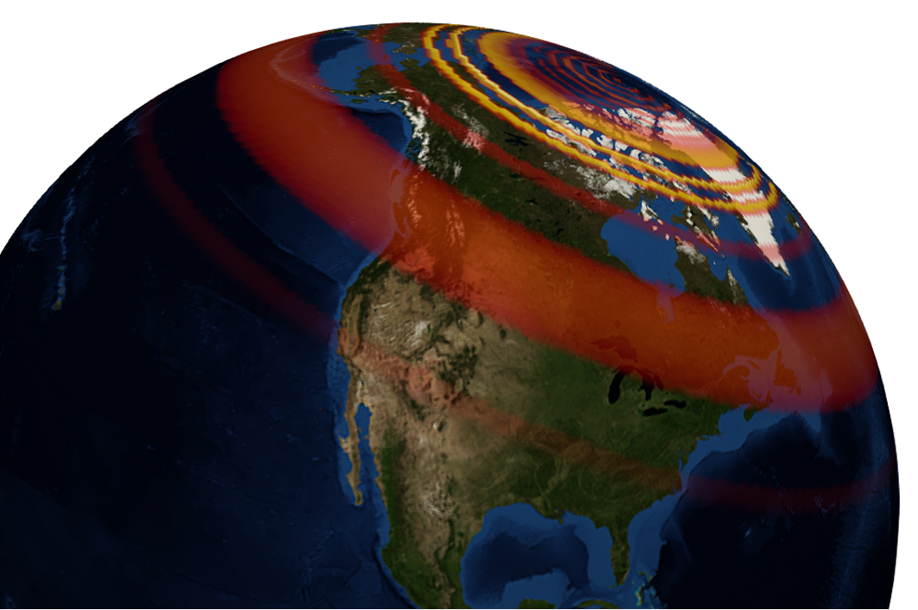
GEOL593: Seismology and Earth Structure, Spring 2023
Lecture 8: Imaging Seismic Discontinuities
3/2/23
Ross Maguire
rossrm@illinois.edu
3014 NHB

Slide 2
Class schedule
 | Dates | Topic | Lab assignment
Week 1: | Jan 17, Jan 19 | Course overview | Lab 1: Python crash course
Week 2: | Jan 24, Jan 26 | Seismic signal processing | Lab 2: Introduction to Obspy
Week 3: | Jan 31, Feb 2 | Moment Tensors/ Inverse methods | Lab 3: Moment tensor inversion
Week 4: | Feb 7, Feb 9 | 🤮 No class, Ross ill | Seismic wave propagation 1
Week 5: | Feb 14, Feb 16 | Lab 4: Reference Earth models: The “1D” Earth | Seismic wave propagation 2
Week 6: | Feb 21, Feb 23 | Lab 5: Surface wave dispersion | Surface waves and normal modes
Week 7: | Feb 28, Mar 2 | Lab 6: Normal modes | Imaging Earth Structure 1: Seismic tomography
Week 8: | Mar 7, Mar 9 | Lab 7: Seismic Tomography | Imaging Earth Structure 2: Seismic discontinuities / Research paper discussion
Week 9: |  | Spring break
Week 10: | Mar 21, Mar 23 | Lab 8. Receiver Functions | Anisotropy and anelasticity
Week 11: | Mar 28, Mar 30 | Planetary seismology 1 | Lab 9: InSight- Seismology on Mars
Week 12: | Apr 4, Apr 6 | Planetary seismology 2
Week 13: | Apr 11, Apr 13 | Machine learning in seismology 1 | Lab 10: Earthquake detection
Week 14: | Apr 18, Apr 20 | Machine learning in seismology 2
Week 15: | Apr 25, Apr 27 | Frontiers of seismology: What’s next?
Week 16: | May 2, May 4 | Research paper presentations

Slide 3
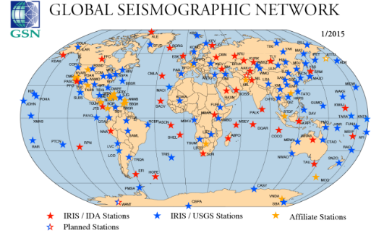
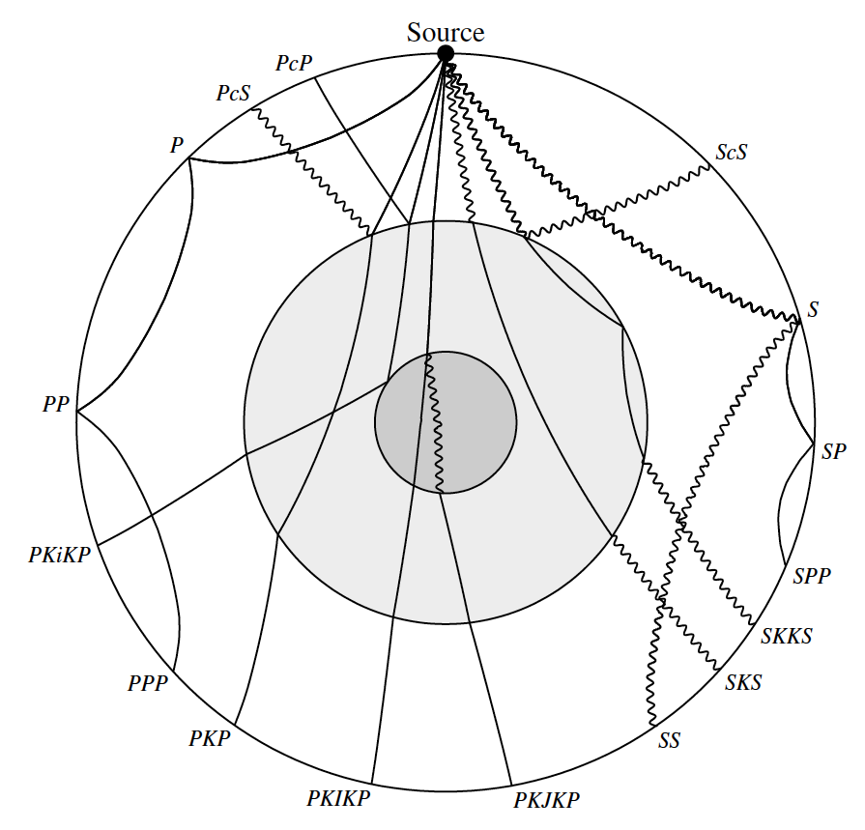
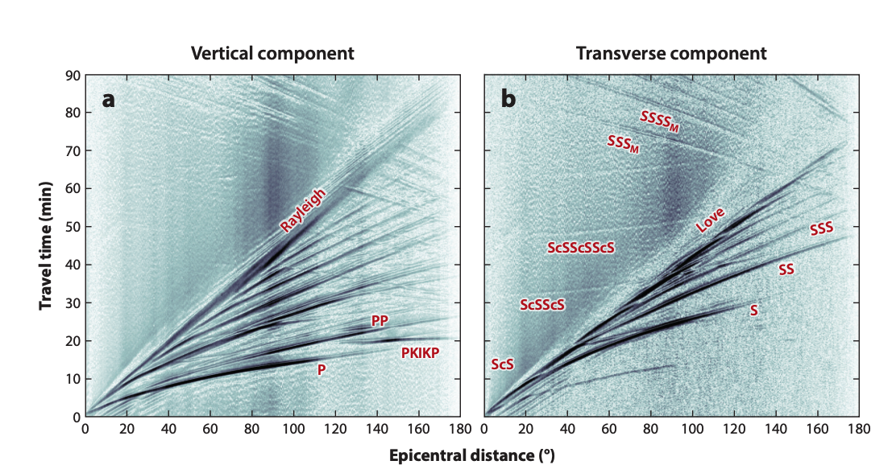
Global seismic observations
Ritsema and Lekic, 2020

Slide 4
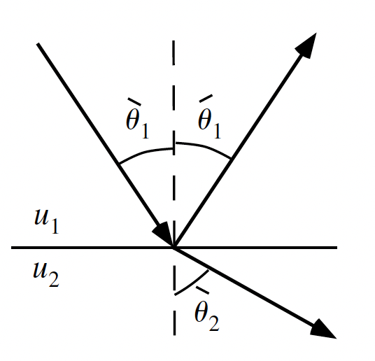
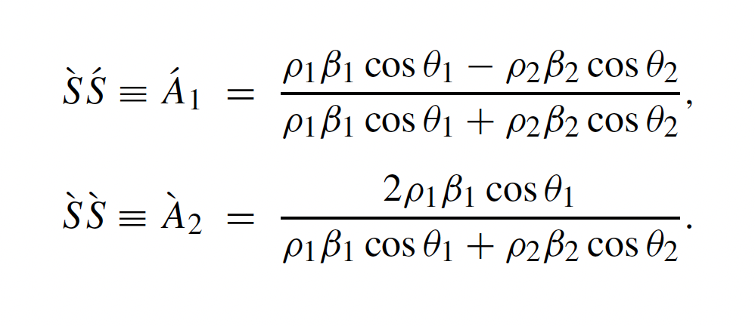
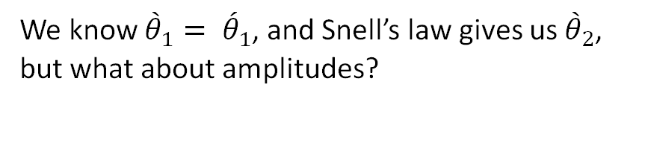
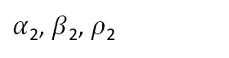
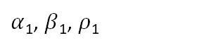
Reflection and transmission
SH system
An incident wave at an interface will produce two waves:
i) The transmitted wave, with passes through the interface
ii) The reflected wave, which bounces off the interface
incident
scattered
$α$₁, $β$₁, $ρ$₁
$α$₂, $β$₂, $ρ$₂
scattered
We know ${\grave{θ}}_{1}= {\acute{θ}}_{1}$, and Snell’s law gives us ${\grave{θ}}_{2}$, but what about amplitudes?
See Shearer, 2009

Slide 5
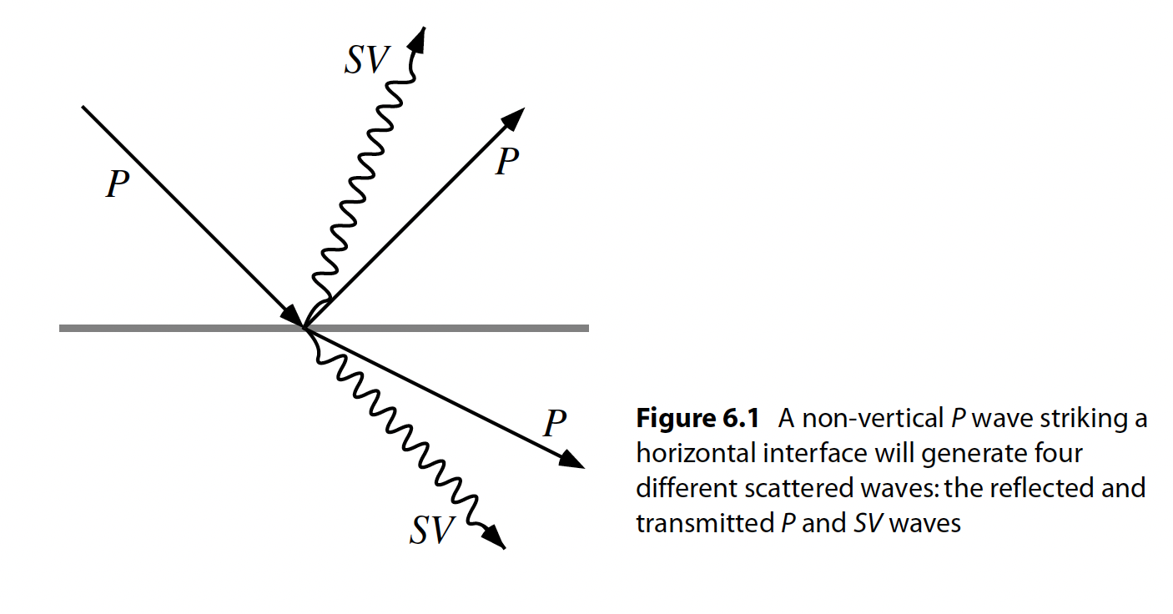
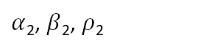
Reflection and transmission
P-SV system
When considering P-SV waves, we have converted phases also.
Now there is the incident wave, and 4 scattered waves to keep track of.
Expressions can be derived for all of the wave types, but it gets messy (see Aki & Richards, 2002)
$α$₁, $β$₁, $ρ$₁
$α$₂, $β$₂, $ρ$₂

Slide 6
Polarity changes
From the vertical incidence reflection formulas, we can see that P and S waves have opposite polarity changes
S waves change polarity (sign) when reflecting from higher impedance layer (e.g. Moho)
P waves change polarity (sign) when reflecting from lower impedance layer (e.g. surface)

Slide 7
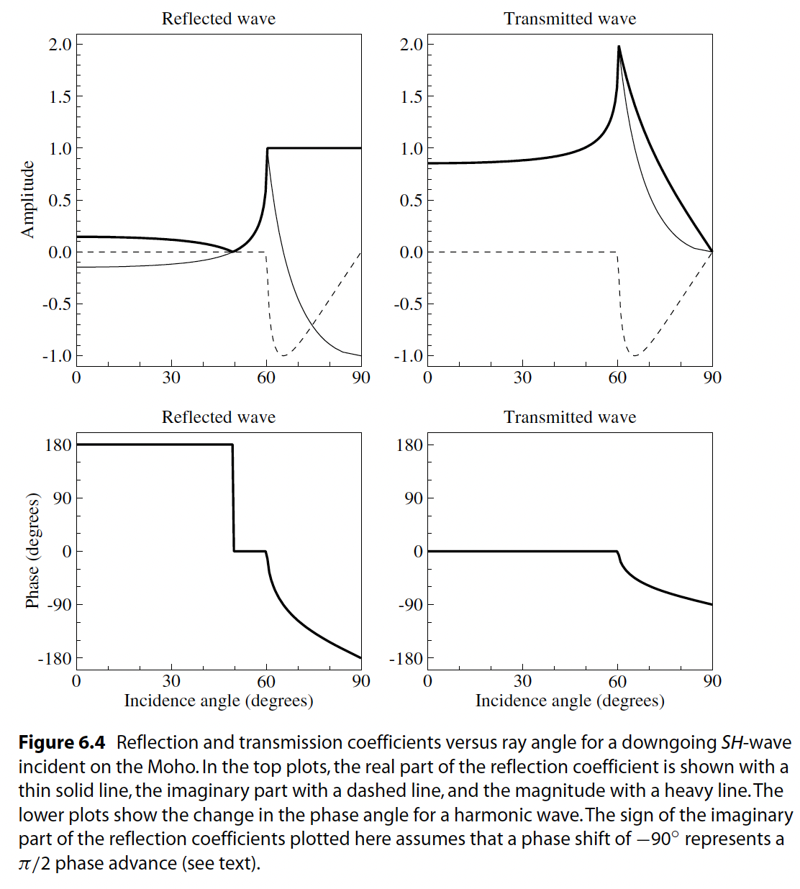
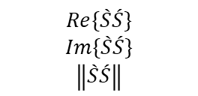

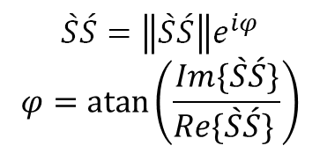
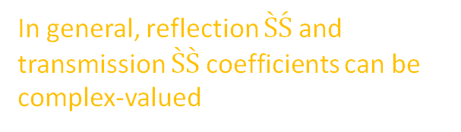
Dependence on angle
$$Re\{\grave{S}\acute{S}\}$$
$$Im\{\grave{S}\acute{S}\}$$
$$\left\|\grave{S}\acute{S}\right\|$$
In general, reflection $\grave{S}\acute{S}$ and transmission $\grave{S}\grave{S}$ coefficients can be complex-valued
$$\grave{S}\acute{S}=\left\|\grave{S}\acute{S}\right\|e^{iφ}$$
$$φ=atan⁡\left(\frac{Im\{\grave{S}\acute{S}\}}{Re\{\grave{S}\acute{S}\} }\right)$$
Complex-valued R/T coefficient can cause a phase shift of $φ$

Slide 8
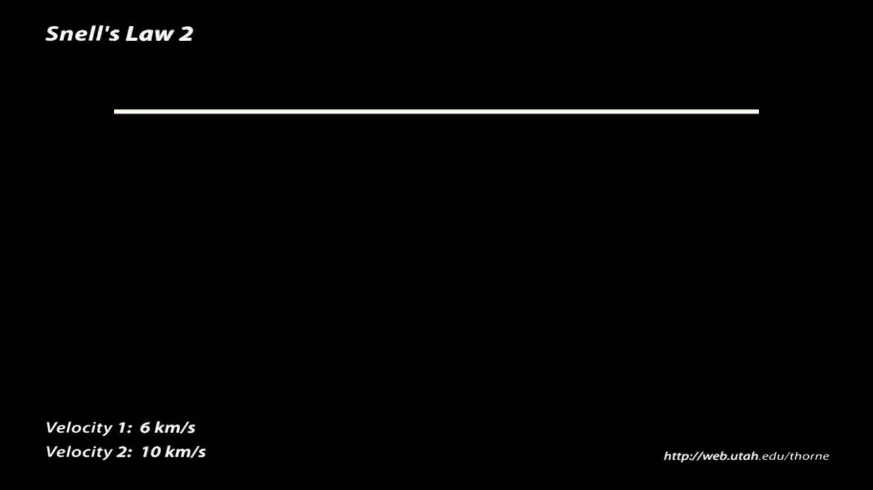

Slide 9
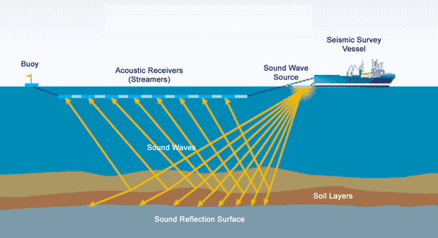
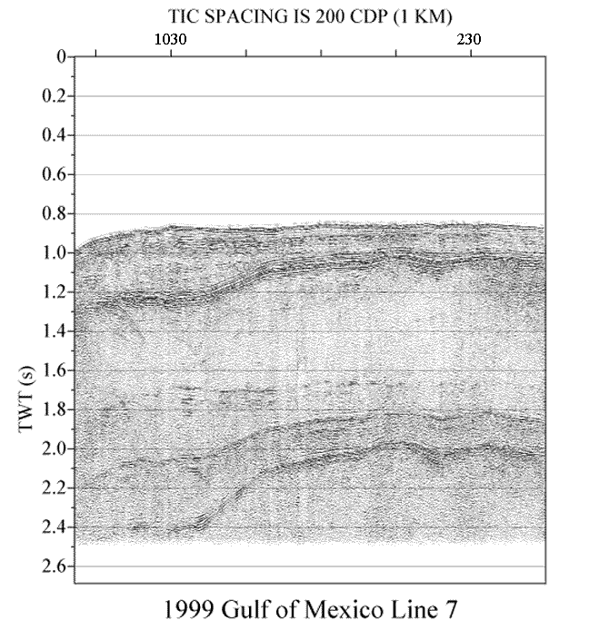
Reflection seismology
Analyze the amplitude and travel time of reflected seismic waves
Mapping reflections to depth requires knowledge of the absolute seismic velocities in the subsurface (refraction analysis is useful there)
Active source reflection seismology is the workhorse of the oil and gas industry

Slide 10
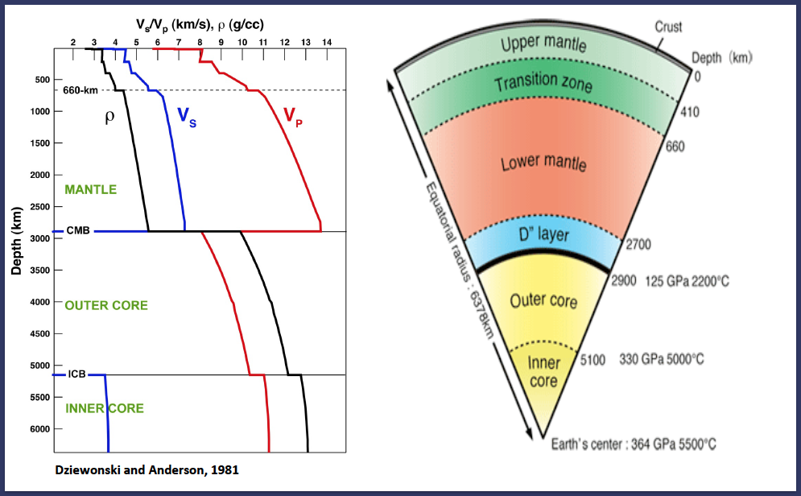
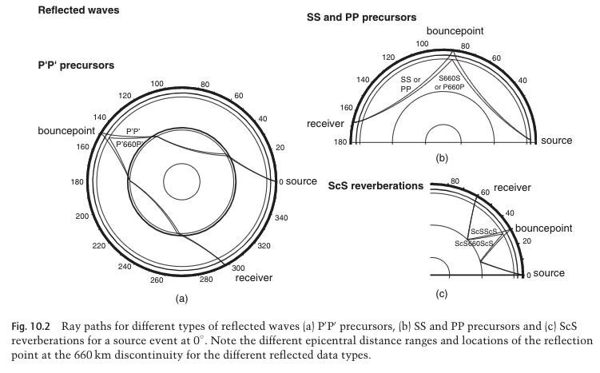
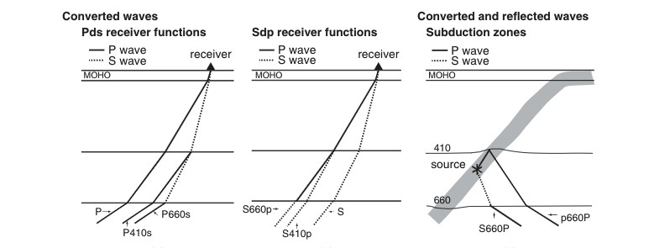
Global imaging of discontinuities
Reflected waves
Converted waves
Deuss et al., (2013)

Slide 11
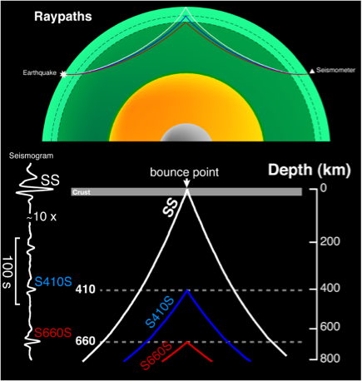
Transition zone imaging with SS and PP precursors
SS (or PP) precursors are waves reflected from a discontinuity in the subsurface and observed before the arrival of the surface-reflected wave
Their amplitude (as a function of epicentral distance) can constrain both Vp, Vs and density jumps across mantle discontinuities!
Figure from Nick Schmerr

Slide 12
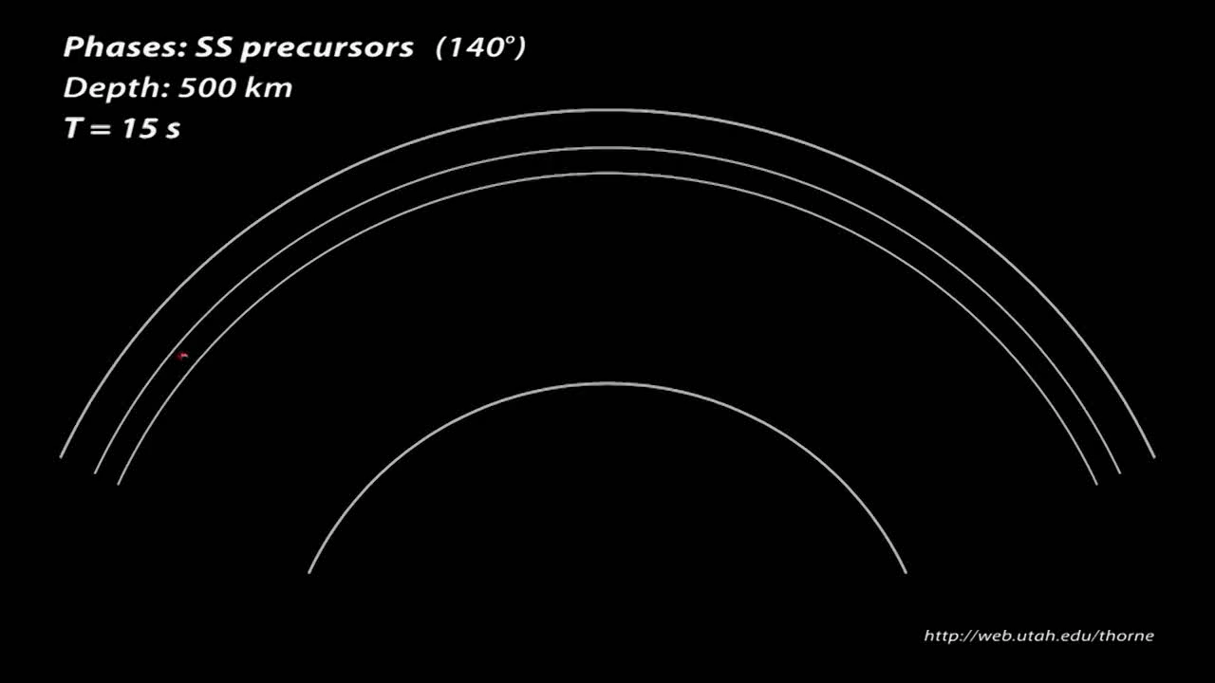

Slide 13
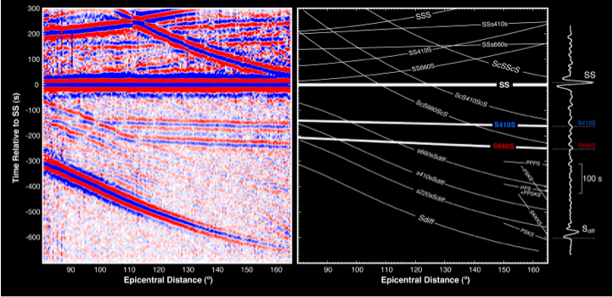
SS precursors

Slide 14
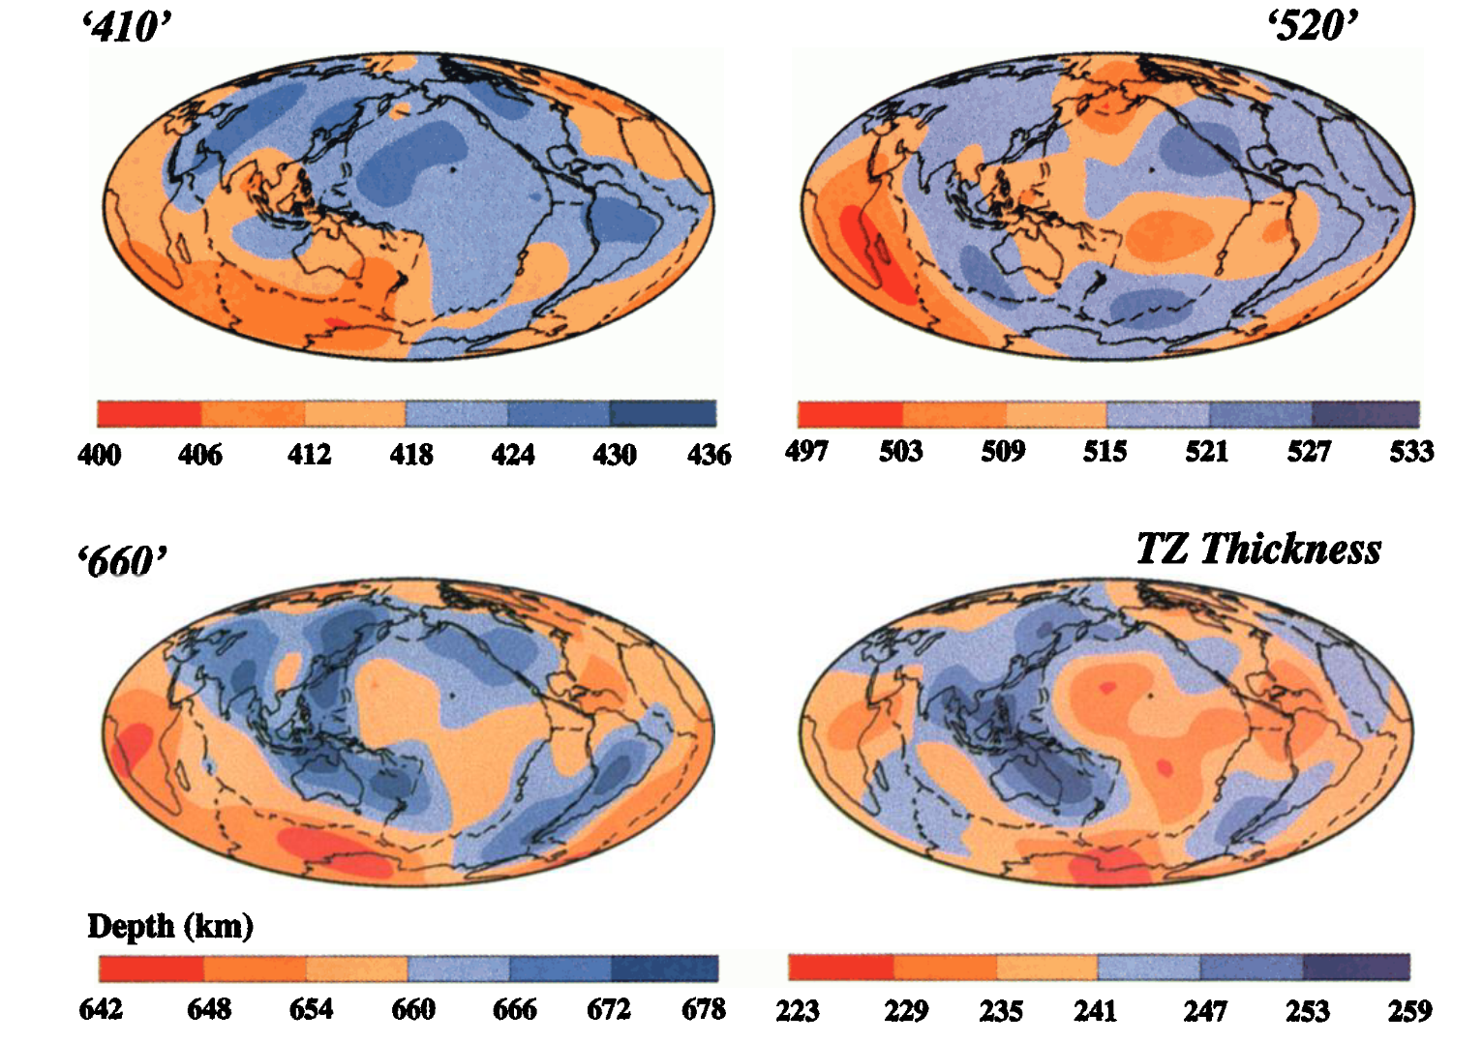
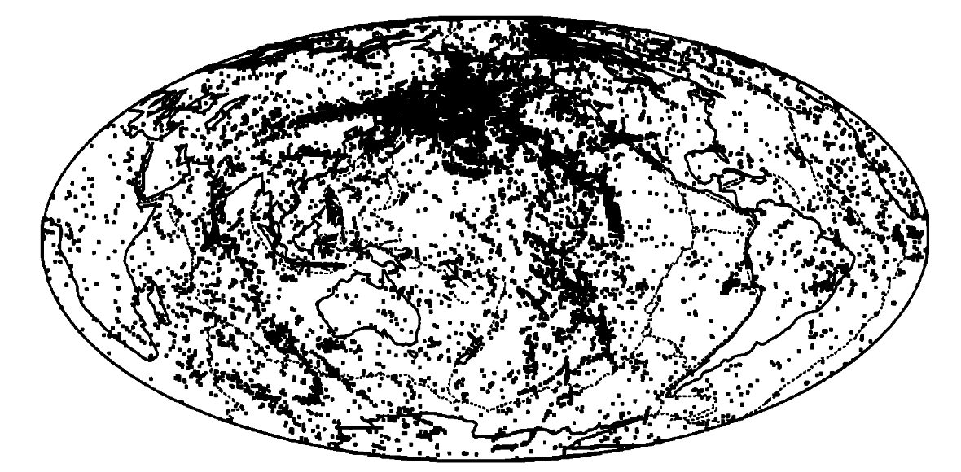
Global transition zone maps
Bounce points
Flanagan & Shearer (1998)

Slide 15
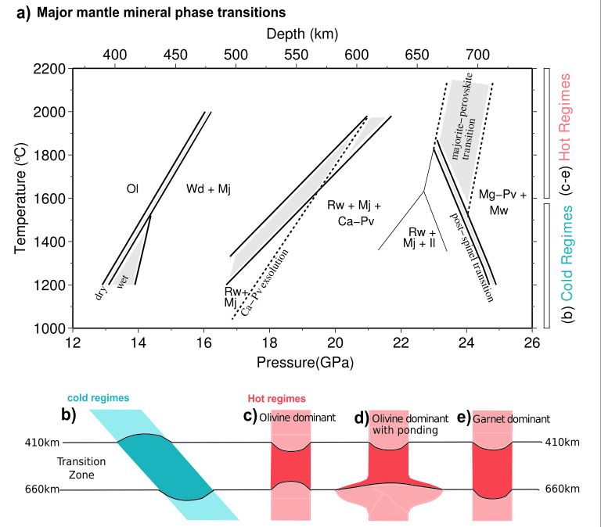

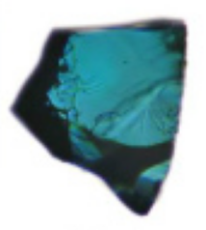
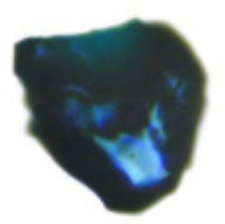
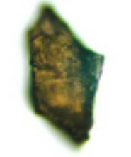
Thermal dependence of the transition zone
Thick transition zone = cold
Thin transition zone = hot

Slide 16
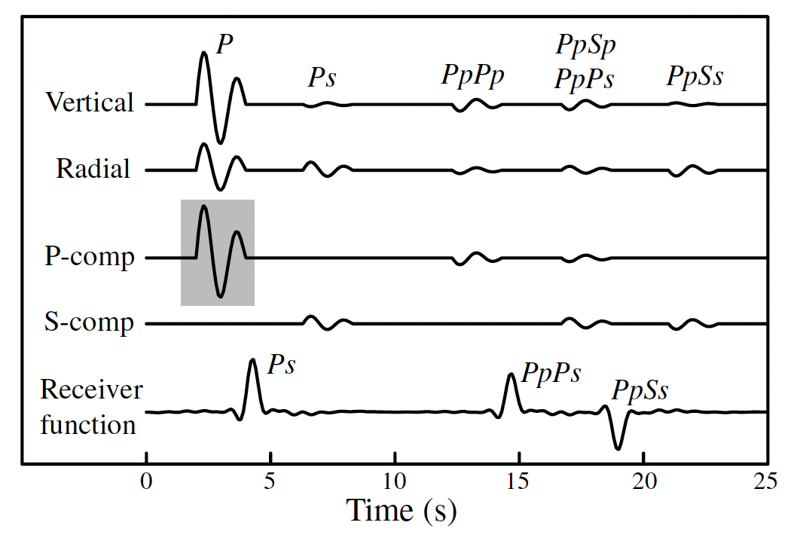
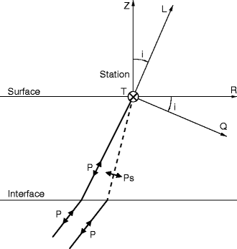
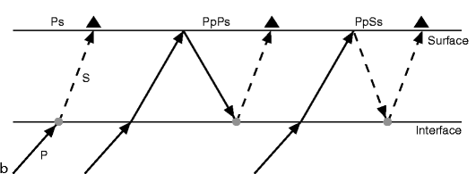
The Ps Receiver-Function technique
The receiver function is a time series that represents the structure of the Earth below a station
At a seismic discontinuity, some incoming P-wave energy will convert to S-wave energy.
The timing between the P-wave and the converted S-wave gives information about the depth to the discontinuity
For distant earthquakes, the incoming rays are steep, so the P-wave is predominantly on the vertical component, and the S-wave is predominantly on the radial component
Kind & Yuan (2014)

Slide 17
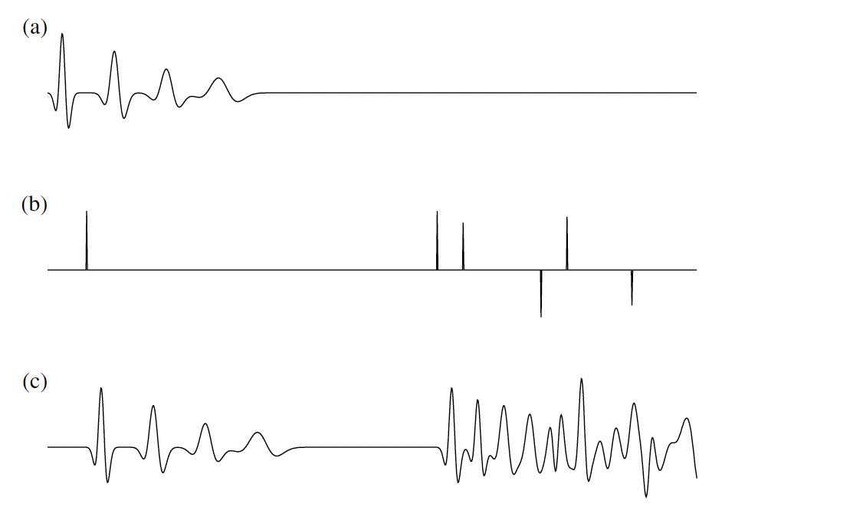
Receiver function calculation
Rotation into RTZ (or LQT) coordinate system.
Deconvolution of Z (L) component from R (Q) component
Deconvolution removes the effect of the seismic source. After deconvolution, all arrivals on receiver function traces should be ‘spike-like’
Shearer (2009)

Slide 18
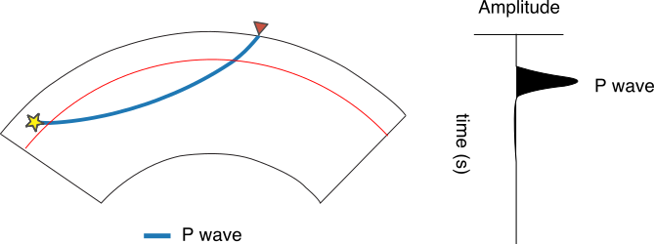
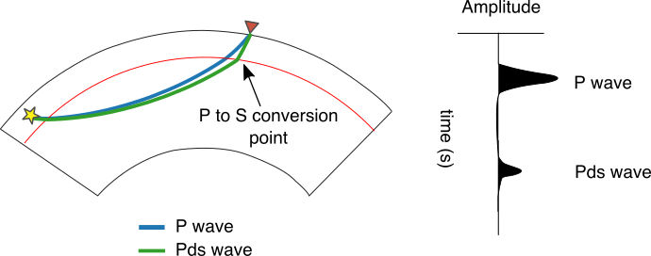
Seismic imaging with receiver functions
Receiver functions isolate P-to-S wave conversions that were generated at vertical seismic discontinuities
Positive arrivals imply a velocity increase with depth, and negative arrivals imply a velocity decrease with depth

Slide 19
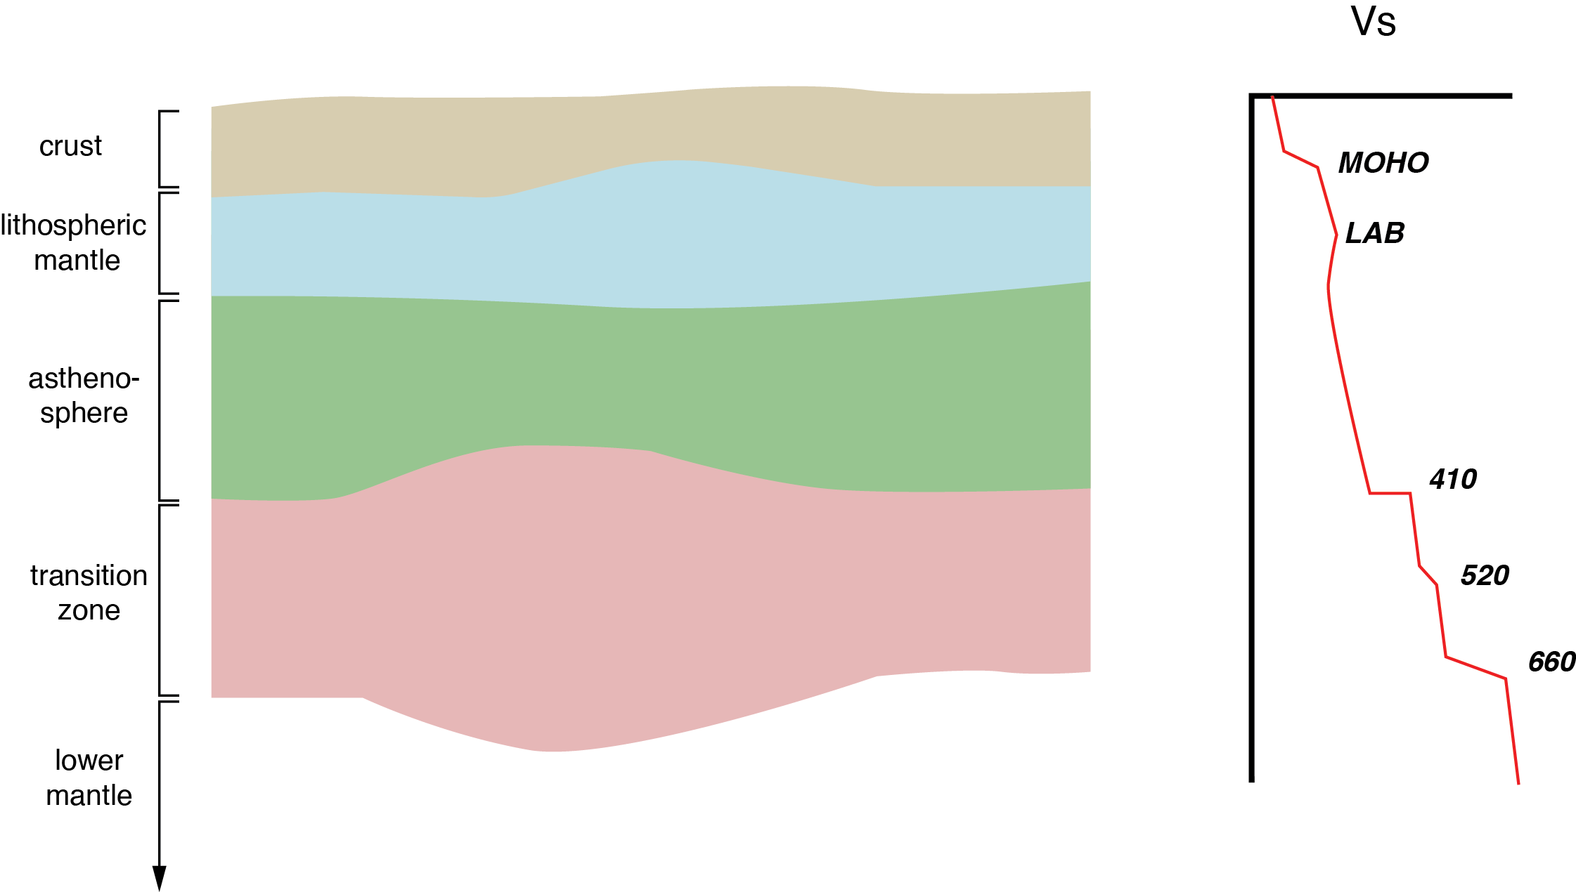
Seismic imaging with receiver functions

Slide 20
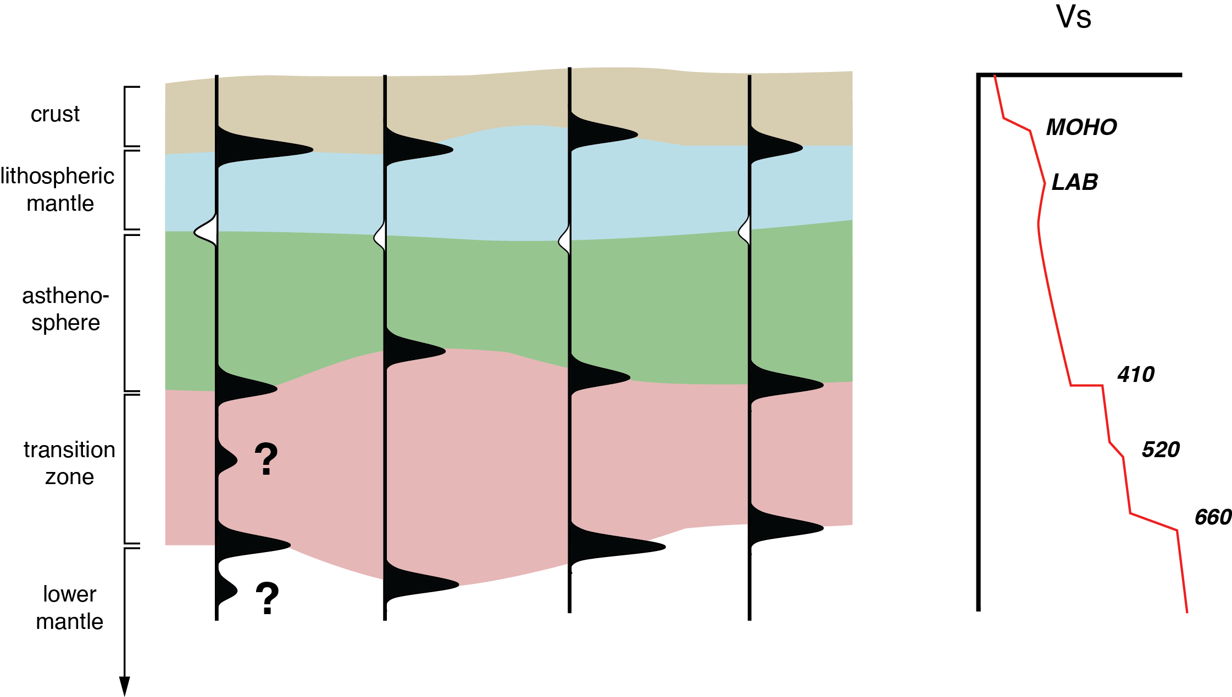
Seismic imaging with receiver functions

Slide 21
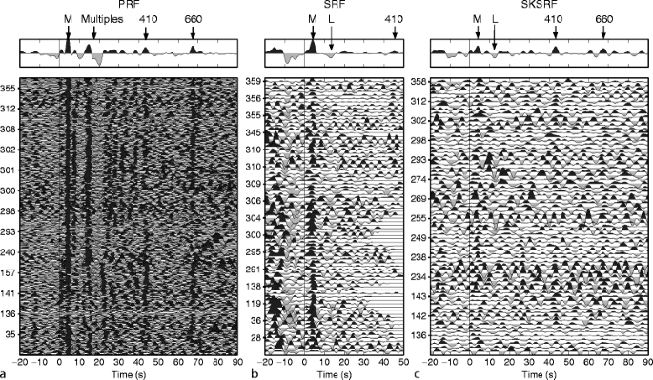
Stacking receiver functions
Individual receiver functions are noisy, and often phases are not clearly identifiable. To increase the signal strength, we stack (average) traces from different earthquakes.
Kind & Yuan (2014)

Slide 22
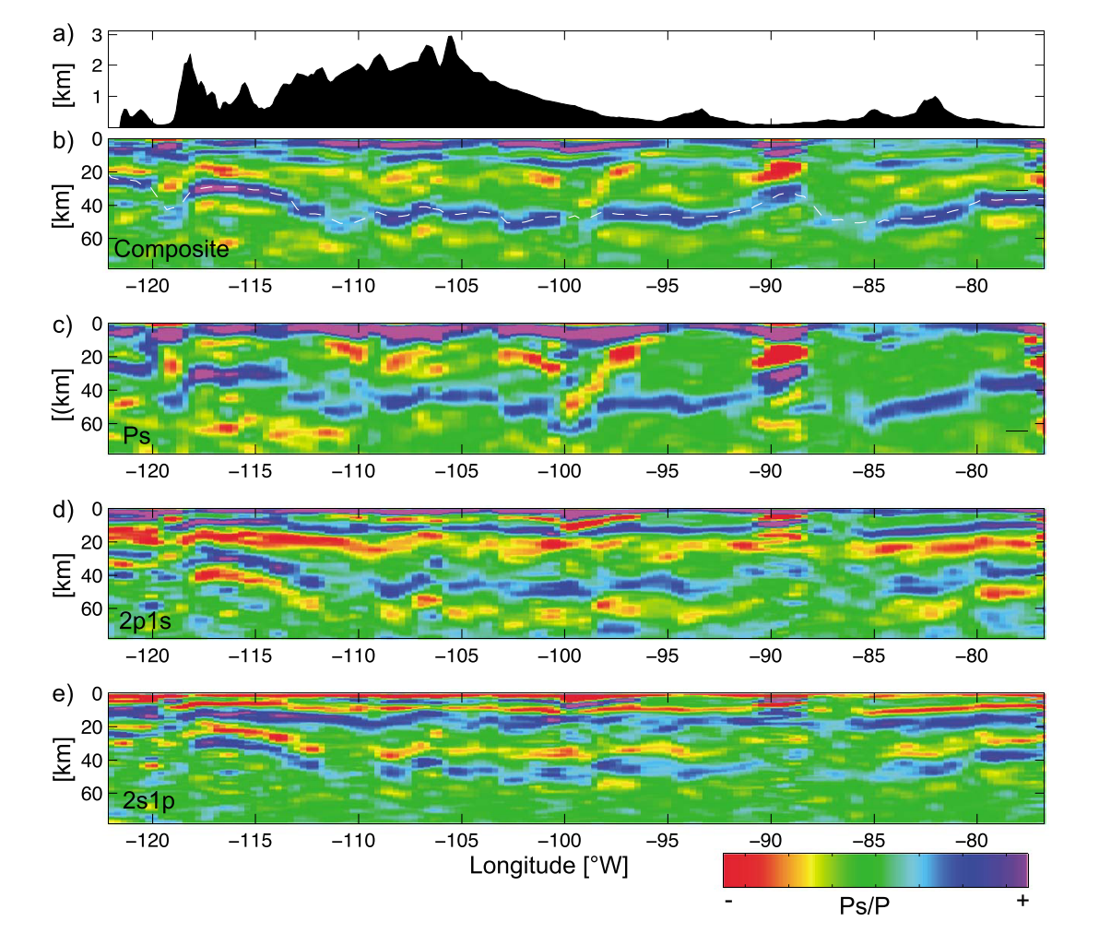
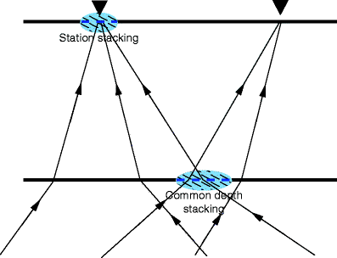
Common conversion point stacking
Receiver functions can either be stacked by station, or by their common conversion points at depth
Schmandt, Lin, & Karlstrom (2015)
Kind & Yuan (2014)

Slide 23
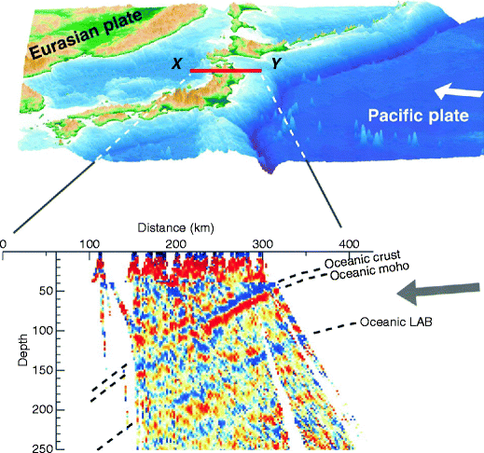
Imaging subduction zone structure
Kawakatsu et al. (2009)

Slide 24
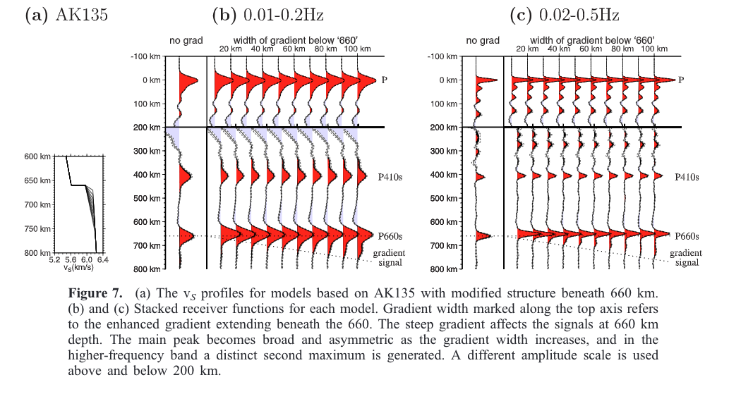
Imaging velocity gradients
The “thickness” of discontinuity (velocity gradient) can be inferred from the pulse shape.
Andrews and Deuss (2008)

Slide 25
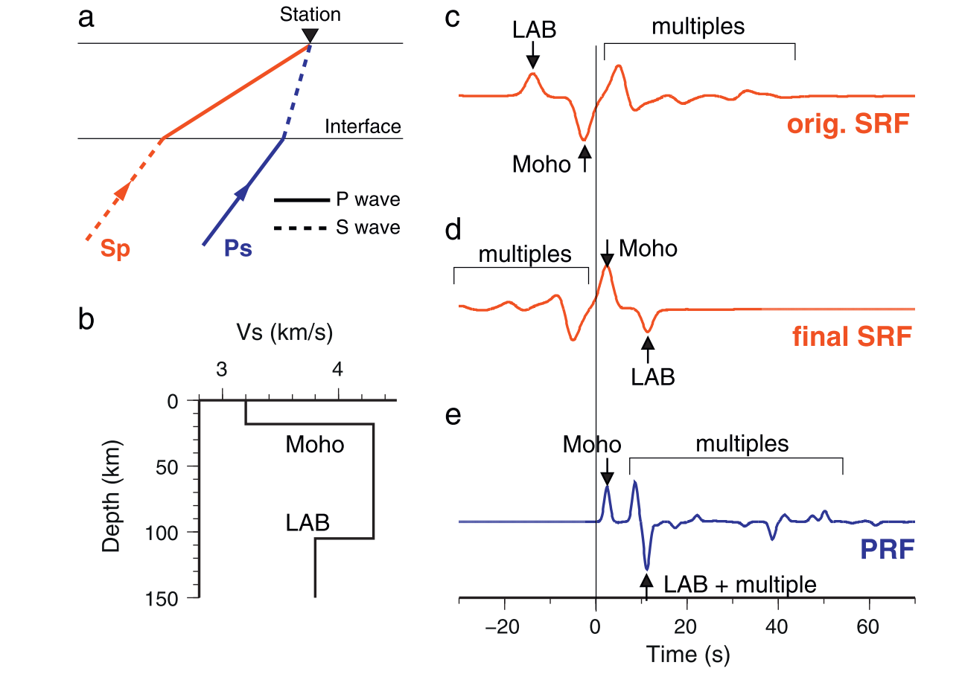
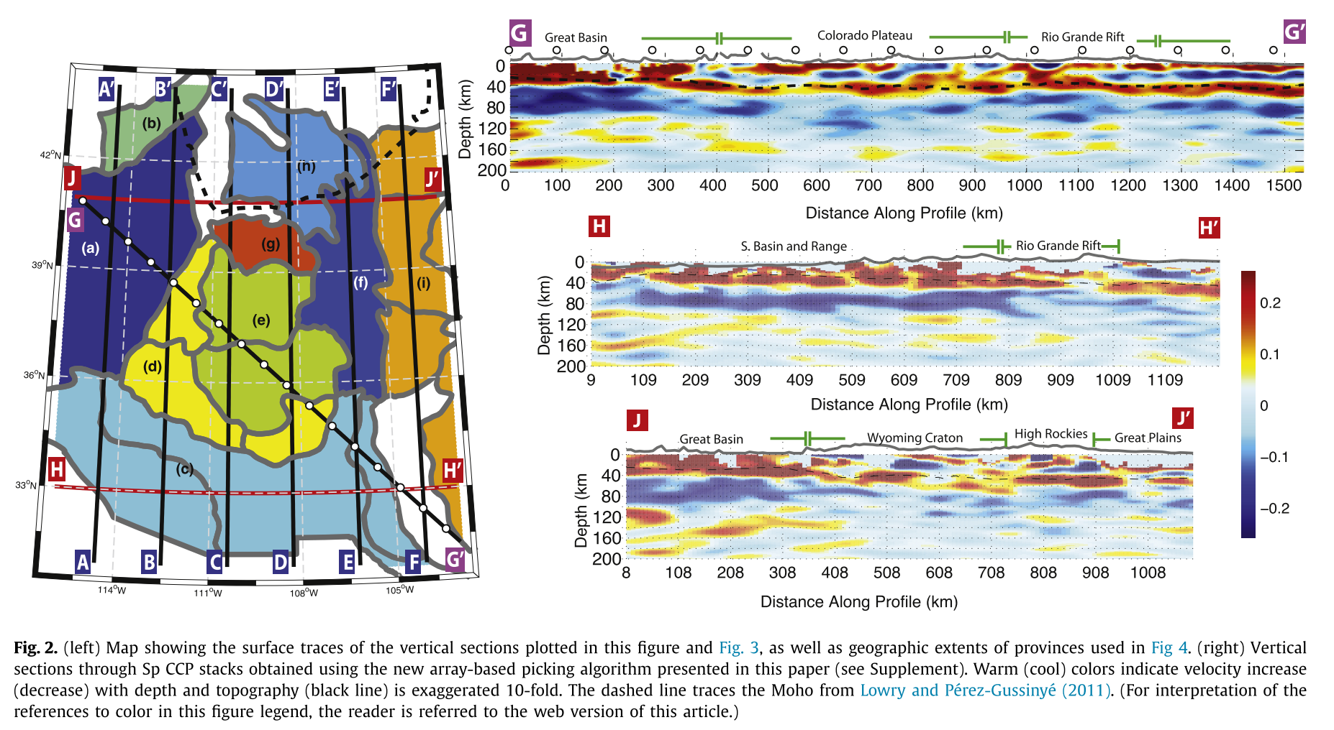
S-to-P receiver functions
S-to-P receiver functions are advantageous for imaging the Lithosphere-Asthenosphere Boundary (LAB) because the LAB-related phase arrives before crustal multiples
Lekic & Fischer (2014)

Slide 26
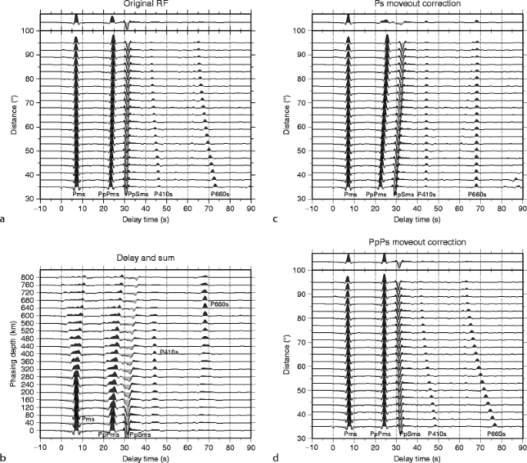
Moveout corrections
Prior to stacking data from different earthquakes, data needs to be ‘corrected’ for the moveout (i.e., the distance dependent effect on travel time)
Kind & Yuan (2014)

